Slide 1


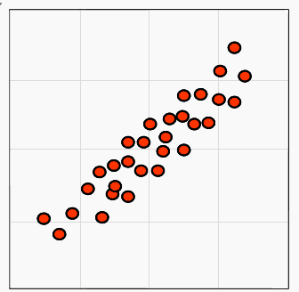


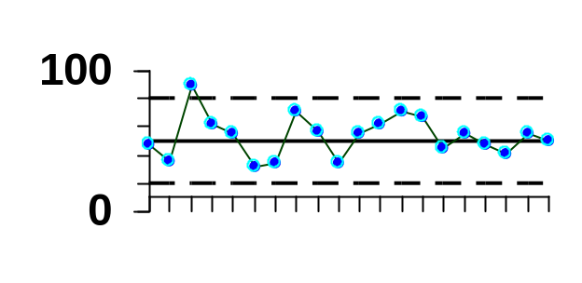
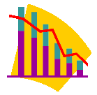
Intro to Quality Tools
Notes:
Briefly explain the tools based on the pictures that we will learn how to use, make, and interpret.
The PowerPoint was developed in 2007. If the PowerPoint is opened in 2003, some of the diagrams and calculations may need to be adjusted.

Slide 2
Problem Solving Model for Continuous Improvement
PDSA
Plan
  Define problem
  Define goals
  Describe existing
  Generate causes and prioritize causes
  Collect data
  Analyze data using statistical tools
  Identify improvement plan
Do -implement
Study-measure the effect of the improvements
Act-standardize the improvements
Notes:
In the other case study for the course we used the 5-7 step problem solving method, now we will use the PDCA method. You should notice the similarities.

Slide 3



How do you define improvement?
Notes:
We are here today to talk about making improvements. With a partner, discuss how do you know you have made an improvement in the workplace?
After each group has reported out, summarize that improvement can only be accomplished when you can compare where you have started to where you ended up. It is also important that individuals agree upon where you should end up. To understand where you have started-baseline, you must collect data.

Slide 4
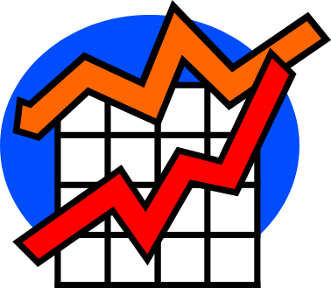
Baseline Data
Baseline data is collected on how things operate now
Baseline data can be compared to data collected after the improvement has been made to show improvement

Slide 5
Problem Definition
PDSA
Plan
  Define problem
  Define goals
  Describe existing
  Generate causes and prioritize causes
  Collect data
  Analyze data using statistical tools
  Identify improvement plan
Describes the problem in terms that are clear and concise
Answers the questions what, who, when, where, and why is it a problem?
Case Study
  Develop a problem definition for Individuals arriving late work and complete in student supplement.
Notes:
If in class use small groups, for online students will develop on their own.
Goal statement can be listed as a question How will ………
Example: Third shift employees are not ready work at 9 p.m.

Slide 6
Define Goals
PDSA
Plan
  Define problem
  Define goals
  Describe existing
  Generate causes and prioritize causes
  Collect data
  Analyze data using statistical tools
  Identify improvement plan
Establishes specific, measurable, and time-targeted objectives
SMARTER
  Specific
  Measurable
  Agrees with or Agreed upon by stakeholders-customer specifications, corporate goals, and team
  Realistic
  Time-bound
  Ethical
  Recorded
Notes:
Depending on the author, the words associated with SMARTER vary. Here the author assigns Agrees to A vs Attainable and Realistic for R vs Relevant. Regardless of which terms you assign to each letter, the purpose of SMARTER is to make sure you have as clear as goals as possible.

Slide 7
Define Goals
Case Study
  Write a SMARTER goal statement for the problem Individuals arriving late to work. Complete in student supplement.
Notes:
After each group has reported out, have groups adjust their goal to be SMARTER.
Individuals on third shift should be at his/her work station at by 9:00 p.m.

Slide 8
Cookie Producer
You work for a cookie manufacturer who produces multiple brands of cookies. You are responsible for inspecting the cookies and counting the chips.
The customers of our cookies expect whole cookies that are not broken.
You must finish your job in 10 minutes and your supervisor is not available.
Notes:
Even though we have written the goal SMARTER. We may need to be more explicit with an operational definition.
Online- grab some cookies, bag of chips, or sleeve of crackers.

Slide 9
Instructions
Write whole cookie
Write # of chips
Record the numbers on the plate
Brand A
Whole cookie 1
# of chips 18
Notes:
If you have additional cookies, have the students who get done early count the additional cookies to increase the sample size.
Students will get frustrated and ask questions about what is considered a whole chip, what is considered whole cookie.
You could prompt them with “what would you do at work if you your supervisor was not around and you had a question?” Small group of students will begin to confer.

Slide 10
Operational Definition
Provides a clear and concise definition of measurement- SMARTER
Provides direction for determining if something is correct/incorrect, pass/fail, or allowed/not allowed
Provides the individual on the job the tool to make the decision
Notes:
Reference how an operational definition would have been helpful with the cookie exercise. Think how common a chocolate chip cookie is and how challenging that was for each of you, now add in the complexity of individuals that may not be familiar with our culture and how challenging it can be not having good operational definitions. How about the goal have a cake done when it comes out of the oven. Well how do you test it finger, toothpick, eat etc.? Operational definitions make it very specific.
Explore the options different ways of communicating an operational definition- written, pictures, templates, checking tools- i.e. it must fit through this hole. Example Auntie Anne’s at the mall that has a pretzel template to make each pretzel by.

Slide 11
Operational Definition
Case Study
  Write an operational definition for the problem Individuals arriving late to work and record in your student supplement.
Notes:
In class have small groups write a operational definition.
Employees on third shift must be dressed, standing at station, machine running, check sheets dated and ready to begin production at 9:00 p.m. based on the clock on the production floor.

Slide 12
Flowcharting
PDSA
Plan
  Define problem
  Define goals
  Describe existing
  Generate causes and prioritize causes
  Collect data
  Analyze data using statistical tools
  Identify improvement plan
  Diagram showing the steps of a process
  Symbols represent specific actions
Start/End
Task/Activity
Decision- needs yes and no alternatives
Notes:
There are many other symbols for more detailed or complex flowcharting.

Slide 13
Flowchart Example
Start
Complete task
YES
Can task be completed correctly by going back through process?
Does task meet Operational Definition?
No
YES
Finish
Scrap/Finish
Notes:
Notice how each decision diamond has a yes and no alternative. All connected symbols end with a finish oval.
Review highlights of flowcharting in text, including the different types of flowcharts deployment, process, and top down.

Slide 14
Benefits of Flowcharting
Provides
  Picture of process
  Baseline of process
  Baseline of understanding of process
  Tool to examine process and cross-functional handoffs
Notes:
Some individuals are visual and a picture of how a process works may be helpful.
We discussed how important baseline data is to continuous improvement. A baseline flowchart can be compared to the improved process flowchart.

Slide 15
Flowcharting
Case Study
  Draft a flowchart for individuals getting to work. You may start the process as early as the night before if they believe activities from the night before are relevant to the problem of arriving late to work. Remember you are only flowcharting the basic process not causes of being late.
  Record in your student supplement.
Notes:
Supplies: Three different Post-its. One rectangle/task, one square/decision, and a different color Post-it for oval-you may want the students to trim Finish/Start Post-it to represent an oval.
Flowchart basic process not causes of being late.
Once flowcharts are complete for each group, provide green and red markers for students to identify what typical works–green and what areas cause problems in the process-red. Students write comments by corresponding Post-its.
The visual of colors assists with identifying problem areas and potential causes and effects.
It can be challenging to frame the focus of where to begin the process/flowchart and where to end the process. The process should end based on the ability to meet the statement goal identified earlier. The process should begin at the a point that first impacts the goal.

Slide 16
Arriving Late to Work- Beginning of the flowchart example
Sleep
Wake Up
Shower
Yes
Dry Hair
No
Get Dressed
Notes:
Typically components of the flowchart
Sleep, wake up, shower yes/no, eat, yes/no, dress, breakfast, kids ready, drive to work, arrive at work.

Slide 17
Affinity Diagram
PDSA
Plan
  Define problem
  Define goals
  Describe existing
  Generate causes and prioritize causes
  Collect data
  Analyze data using statistical tools
  Identify improvement plan
Organizes a large group of brainstormed ideas
Allows for individuals to express their ideas without criticism.
Notes:
Sleep might have a lot of red identified by it because causes could be drunk, watched movie, etc
Didn’t check schedule,
Wake up- didn’t set alarm

Slide 18
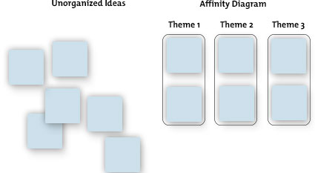
Affinity Diagram
http://www.mindtools.com/pages/article/newTMC_86.htm Retrieved 12/31/14

Slide 19
Affinity Diagram
Case Study
  Individually write on a Post-it what you believe is the number one reason why Individuals arrive late at work.
  Individually post your idea on the board.
  Read the other posts already posted
  Place your Post-it idea next to other ideas that are similar to yours, or if there is not another post similar to yours, start a new grouping.
  After everyone has posted, determine header for each group
  Record affinity headers in your student supplement .
Notes:
An affinity diagram is a great place to start to begin identifying root causes.
Interpret the chart

Slide 20
Benefits of Affinity Diagram
Large group brainstorming completed in just a few minutes
Ideas organized by individuals
Everyone participates
Ranking of ideas are visual based on number of Post-its per grouping
Anonymous
Notes:
Review Affinity Diagram in student supplement.

Slide 21
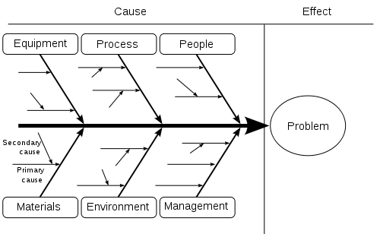
Cause and Effect/Fishbone
PDSA
Plan
  Define problem
  Define goals
  Describe existing
  Generate causes and prioritize causes
  Collect data
  Analyze data using statistical tools
  Identify improvement plan
  Brainstorming tool to identify root causes
  Ask why five times
http://en.wikipedia.org/wiki/File:Ishikawa_Fishbone_Diagram.svg
Notes:
The typical template for a cause and effect of fishbone has major bones of equipment, process/methods, people, materials, environment, and management. For our case study, we are going to make the major bones the headers of our Affinity diagram.
Typically the headers of the affinity for diagram will weather, kids, didn’t set alarm, didn’t check schedule, etc.

Slide 22
Cause and Effect/Fishbone
Case Study
  Complete a Cause and Effect for Individuals arriving late at work in your student supplement.
Notes:
Interpret the chart
Weather caused me to be late-why, didn’t check forecast why, didn’t care, why don’t you care, no penalties for being late.
Traffic- caused me to be late- why, didn’t leave early enough, why didn’t care, why no penalties for being late
Alarm not set-why, hung over, why partied night before, why don’t care, why no penalties for being late.

Slide 23
Benefits of Cause and Effect
Visual of causes and effect
Promotes understanding of causes
Group or team activity
Assists in identifying root cause through asking why 5 times

Slide 24
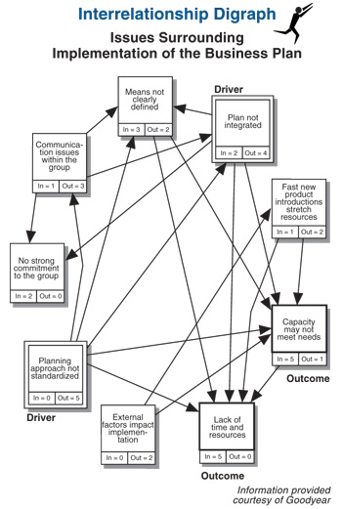
Interrelationship Digraph
PDSA
Plan
  Define problem
  Define goals
  Describe existing
  Generate causes and prioritize causes
  Collect data
  Analyze data using statistical tools
  Identify improvement plan
  A visual diagram that helps differentiate between causes and effects
  A systematic way to discuss and analyze causes
http://www.qicbok.com/tools/images/TQMimages/IDsurrounds2.jpg

Slide 25
Interrelationship Digraph
Case Study
  Refine Affinity headers based Cause and Effect exercise
  Place Post-it headers in a circle
  Gain consensus on whether arrows go in or out
  Only one directional arrow can be draw between two headers
  Complete digraph in student
  supplement
A
No two headed arrows. A can not be a cause and effect of C
C
B
Header A is the cause or driver of B, B is the effect or outcome
Notes:
Place headers in a circular pattern.
Define Consensus- after discussion of different ideas, a direction is determine that everyone can support, you may not necessarily agree 100%, but for the sake of moving forward you will support.
As a whole class determine arrow direction. Start with the top header and ask does the top header cause/driver of the next header? If yes, draw the arrow from the top header to the next header. The arrow can only go one way between two headers. Continue until you have addressed each header. Count the number of out and in arrows. A higher number of outs represents cause/driver, the higher number of ins represents effect or outcome.
Interpret the chart.
Review interrelationship digraph information from student supplement.
We use Traffic and alarm not being set as the an example with being late to work in mind. Does traffic cause the alarm not being set or does not having alarm set cause traffic to make us be late. The arrow can only go one way. Alarm not set would cause traffic to make us late so the arrow would go from alarm not set to traffic.
If we incorporate the outcome of the cause and effect, no penalty for being late. Does no penalty for being late cause the alarm not set or vise versa, doe no penalty for being late cause traffic to make us late or vise versa. What you should find is one or two causes that have more out arrows or are the root causes. In this cause, it may be because there are no penalties for being late, individuals don’t plan and have a lot of accuses. If there were a penalty for being late individuals would plan ahead and make contingency plans.

Slide 26
Benefits of Interrelationship Digraph
Visual of cause and effects
Promotes understanding of causes
Group or team activity
Assists in determining drivers/ causes and outcomes/effects
Narrows down the number of causes to focus on

Slide 27
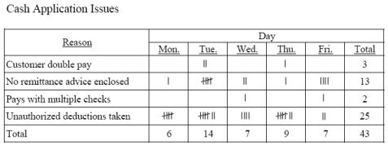
Check sheet
PDSA
Plan
  Define problem
  Define goals
  Describe existing
  Generate causes and prioritize causes
  Collect data
  Analyze data using statistical tools
  Identify improvement plan
  Systematic way to record and compile data
  Visual tool
  Simple to develop
  Easy to use
Notes:
Now that we have narrowed down the potential root causes through the use of the flowchart, affinity diagram, and interrelationship digraph, it is time to collect baseline data.
Your data collection utilizes the clarity of your operational definition. Each reason or cause listed must be clearly understood so the individual knows when to put a tally mark.

Slide 28
Check sheet- Cookies Brand A
 | Count | Total
Whole Cookies | 1111 1111 1111 111 | 18
18 | 11 | 2
19 | 111 | 3
20 | 111 | 3
21 | 1111 1111 | 10
22 | 11 | 2
23 | 11 | 2
24 | 1 | 1
25 | 1111 1111 111 | 8
26
27
28
Notes:
Back to our cookie example. Make your tallies as even as possible to be able to later use the check sheet to show a histogram. You will want to save the flip charts week to week.

Slide 29
Check sheet
Case Study
  Draft a check sheet for Individuals arriving late to work using the top four drivers/causes from the cause and effect and interrelationship digraph. Use the data provided below.
  Record in your student supplement.
 | Cause 1 | Cause 2 | Cause 3 | Cause 4 | Cause 5
Worker A | 3 | 2 | 0 | 0 | 0
Worker B | 7 | 2 | 1 | 1 | 1
Worker C | 7 | 3 | 2 | 1 | 1
Worker D | 0 | 0 | 0 | 0 | 0
Worker E | 12 | 8 | 3 | 1 | 1
Worker F | 3 | 3 | 4 | 0 | 0
Notes:
Draft check sheet on flip chart. Make tally marks consistently.
Students assign cause and effect headers to cause 1, 2, etc.
Interpret the chart.

Slide 30
Pareto
PDSA
  Visual bar chart
  Shows relative frequency by sorting the data by largest data occurrences to lowest data occurrences
  Focus attention on “vital few”
  Identify where to focus limited resources for biggest impact
  Example in student supplement
Plan
  Define problem
  Define goals
  Describe existing
  Generate causes and prioritize causes
  Collect data
  Analyze data using statistical tools
  Identify improvement plan
Notes:
The term Pareto Effect, or the Pareto Principle, is based upon the research of Italian economist Vilfredo Pareto, whose 19th century study established that 80% of the land in Italy was owned by 20% of the population. The Pareto chart is used to organize and visualize the comparison between variables. Looking at this chart, it is obvious that if two of variables/defects were addressed that 75% of the defects would be taken care of. 80/20 rule 80% of problems are caused by 20% of the causes.
In the student supplement notice how causes have been sorted with highest occurrence listed first. Once you have sorted the causes in order, calculate the accumulation number of occurances. Note 15 weather and 12 illness equals the 27. Add 11 equals 38 in the cumulative column. Finish calculating the cumulative amount. Now you need to figure the individual. I %. In the example 15/49 equals 31%, 12/49 equals 24% and so on. You then calculate the cumulative %.

Slide 31
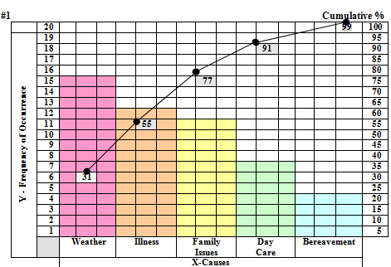
Pareto
PDSA
Plan
  Define problem
  Define goals
  Describe existing
  Generate causes and prioritize causes
  Collect data
  Analyze data using statistical tools
  Identify improvement plan
Cause | No. of Absences | Cumulative | Percentage | Cumulative
Weather | 15 | 15 | 31% | 31%
Illness | 12 | 27 | 24% | 55%
Family Issues | 11 | 38 | 22% | 77%
Day Care | 7 | 45 | 14% | 91%
Bereavement | 4 | 49 | 8% | 99%
Total | 49 |  | 99%

Slide 32
Pareto- Individuals arriving late
Pareto-order causes with highest number of occurrences first to lowest number of occurrences
Complete the Pareto in the student supplement using data from check sheet.
Cause # of occurrences Cumulative Percent Cumulative %
Notes:
Using the information from the check sheet completed, complete the information needed for the Pareto
Guided demonstration on board and individual completion. Explain the step, have students complete the step, and validate everyone has completed the step correctly before moving on to the next step.
Student supplement has template.

Slide 33
Check sheet data to complete Pareto
  Remember to label your causes based on what you completed previously
  Interpret the chart
 | # of occurrences | Total
Cause 1 | xxxxxxxxxxxxxxxxxxxxxxxxxxxxxxxx | 32
Cause 2 | xxxxxxxxxxxxxxxxxx | 18
Cause 3 | xxxxxxxxxx | 10
Cause 4 | xxx | 3
Cause 5 | xxx | 3

Slide 34
Pareto
Individual Exercise –Causes of Accidents found in your student supplement
Interpret the chart

Slide 35
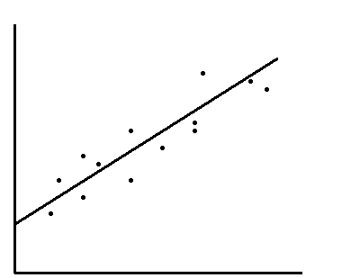
Scatter diagram
PDSA
Plan
  Define problem
  Define goals
  Describe existing
  Generate causes and prioritize causes
  Collect data
  Analyze data using statistical tools
  Identify improvement plan
  Visual tool
  Shows the relationship between two variables
  Simple to develop
  Easy to use
Effect
Cause
Notes:
It is common that the “cause” variable be labeled on the X axis and the “effect” variable be labeled on the Y axis.

Slide 36
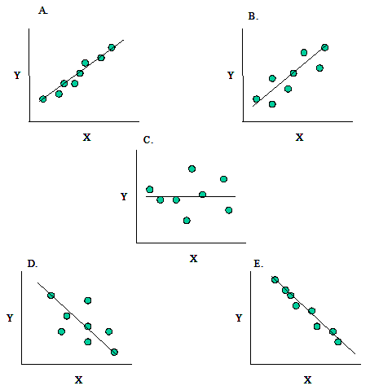
Correlations
http://www.spcforexcel.com/files/images/correlations.gif
Notes:
Scatter Diagram determines strength of relationship
A –Strong Positive - as one variable increases, so does the other.
B- Weak correlation
C- No Correlation – no variable has any particular relationship with the other.
D. Weak negative correlation
E. Strong Negative - as one variable increases, the other decreases.

Slide 37
Times late | Age of children
3 | 15
2 | 17
16 | 2
17 | 2
15 | 1
13 | 5
12 | 6
11 | 7
10 | 8
9 | 9
9 | 10
9 | 11
9 | 12
7 | 12
5 | 13
5 | 14
3 | 15
4 | 16
1 | 16
15 | 4
1 | 18
Complete scatter diagram in your student supplement.
Scale and label X axis with the cause variable- age of children. Start with 0 to the oldest age listed
Scale and Label Y axis with the effect variable –times late, Start with 0 to highest number of occurrences
Interpret the chart
What predictions can you make?
Notes:
Complete a scatter diagram

Slide 38
Times late
Age of children
Notes:
Interpret
Obviously the age of children does have a strong correlation with the # of absences.

Slide 39
Scatter
Individually complete a scatter diagram correlating age and absences found in your student supplement.
Interpret the chart

Slide 40
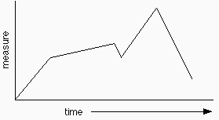
Run Chart
PDSA
Plan
  Define problem
  Define goals
  Describe existing
  Generate causes and prioritize causes
  Collect data
  Analyze data using statistical tools
  Identify improvement plan
  Visual tool
  Displays data over time
  Each point is a measure or observation
  Shows trends over time
  Helps understand the natural variability of a process
  Show the relationship to the calculated average

Slide 41
 | # of People late
M | 6
T | 1
W | 2
R | 2
F | 1
M | 7
T | 2
W | 3
R | 1
F | 2
M | 10
T | 1
W | 3
R | 2
F | 3
M | 7
T | 2
W | 3
R | 4
F | 2
Number of people late over the past four weeks.
Complete a run chart
Template-Student supplement
Interpret the chart

Slide 42
Number of People Late

Slide 43
Run Chart
Calculated average
 | # of People late
M | 6
T | 1
W | 2
R | 2
F | 1
M | 7
T | 2
W | 3
R | 1
F | 2
M | 10
T | 1
W | 3
R | 2
F | 3
M | 7
T | 2
W | 3
R | 4
F | 2
Calculate the average number of people who are late each day by totaling the number of absences and dividing by the number of occurrences. Draw the average line on your chart.

Slide 44
Number of People Late
Notes:
Average 3.2
Do you see any patterns?

Slide 45
Pareto
 | # of People late
M | 6
T | 1
W | 2
R | 2
F | 1
M | 7
T | 2
W | 3
R | 1
F | 2
M | 10
T | 1
W | 3
R | 2
F | 3
M | 7
T | 2
W | 3
R | 4
F | 2
The run chart show some trends in the data. Construct a Pareto diagram using the # of people late by day.
Record in student supplement.
Interpret the data.
Notes:
50% of problem on Mondays.

Slide 46

Histogram
PDSA
Plan
  Define problem
  Define goals
  Describe existing
  Generate causes and prioritize causes
  Collect data
  Analyze data using statistical tools
  Identify improvement plan
  Visual tool
  Bar chart
  Shows frequency of distribution
  Displays variation, central tendency, range ,and shape

Slide 47
Measures of Central Tendency
Times late
3
2
16
17
15
13
12
11
10
9
9
9
9
7
5
5
3
4
1
15
1
Mean- Average
Median- Middle
Mode-Data Point that repeats itself the most
Range- Spread from lowest to highest
Shape-indicates movement in distribution
Calculate and record in student supplement
Notes:
What is the mean/average –add numbers and divide by the total number of occurrences. 176/20= 8.8

Slide 48
Median- Middle
Mode-Data Point that repeats itself the most
1 | 1 | 2 | 3 | 3 | 4 | 5 | 5 | 7 | 9 | 9 | 9 | 9 | 10 | 11 | 12 | 13 | 15 | 15 | 16 | 17

Slide 49
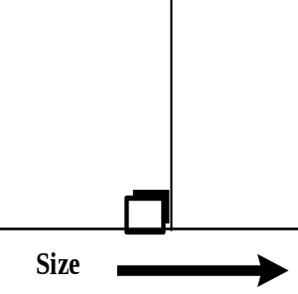
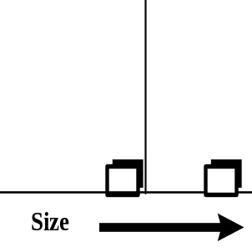
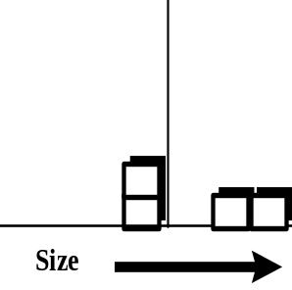
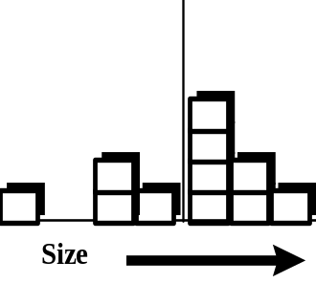
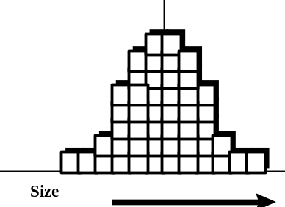
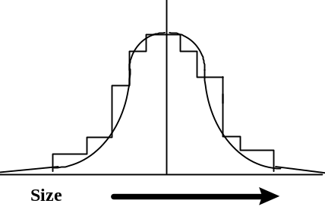
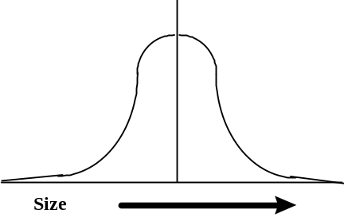
Shape
Wisconsin Technical College System Board (1998). Foundations of Quality. Module 1
Notes:
Normal curve or distribution indicates the process is stable and producing output consistently. Think about getting an ice cream cone made at a restaurant. Are they always exactly the same size? No, they vary from each other. The key to quality is to make the process happen as consistent as humanly possible each time it is done. The key to improving quality is to stabilize the process so it is consistent to be able predict what the output will be (bell or normal curve) by diminishing causes of variation over time. The above diagram shows the collection of sizes of cones. Sometimes they are smaller than the average; sometimes they are more than the average, but most hover around the centerline or average.

Slide 50
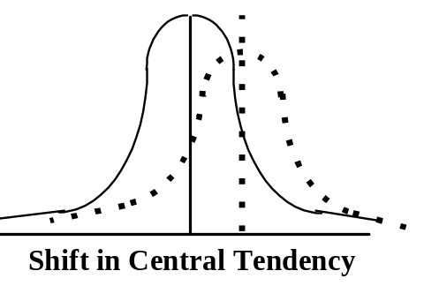
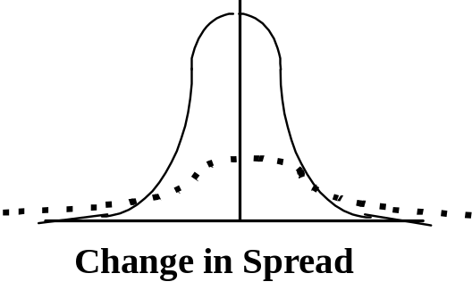
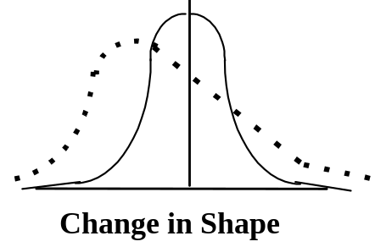
Shape
A
B
C
Wisconsin Technical College System Board (1998). Foundations of Quality. Module 1
Notes:
Each of the shifts illustrated here would indicate that the process is not operating consistently and is changing in some manner. If it were not changing, the shape of the distribution would be in what is called a “bell curve” illustrated in the diagrams above with the solid lines. The distribution where the shift has occurred is illustrated by the dotted line.
Panel #A - In the first panel you can see that cones are consistently being made larger than the average, although the distribution seems to have a normal shape which would mean it is at least consistent, unfortunately they are being made consistently larger than the norm.
Panel #B – There has been a change in the spread of the data. This means that there is a much larger difference in the smallest to the largest cone. This is illustrated by the width or how wide the distribution is from highest value to lowest. It would indicate that the amount of time is varying a great deal from one occurrence another.
Panel #C – There is a shift in the distribution where there seems to be a group of values moving right or left. This is known as a “skewed” distribution. It indicates that something in the process is shifting while it is going if only common causes of variation are present; the output of a process forms a distribution that is stable over time and is predictable.

Slide 51
Improvement Plans
PDSA
Plan
  Define problem
  Define goals
  Describe existing
  Generate causes and prioritize causes
  Collect data
  Analyze data using statistical tools
  Identify improvement plan
  Based on statistical analysis to
  determine the root cause(s)
  determine decision criteria
  brainstorm solutions
  compare solutions to decision criteria
  develop improvement plans
        Timeline with tasks and how progress toward goals will be measured

Slide 52
Do
PDSA
Do
  Implement improvement plan
  Implement improvement plans

Slide 53
Study
PDSA
Study
  Compare baseline data to new process data
  Measure the effect of improvements by comparing baseline data to data collected after improvement has been implemented

Slide 54
Act
PDSA
Act
  Standardize the improvements
  Start back at plan if improvements didn’t achieve goal.
  Standardize the improvements if they met the goal
  Complete the implementation plan section in the student supplement.
Notes:
Standardize-written procedures, training, new SOPs.

